Slide 1


GUJARAT TECHNOLOGICAL UNIVERSITY
Shri S’ad Vidya Mandal Institute of Technology
affiliated with GTU
Enterprise Resource Planning
PREPARED BY:
HETVI H. PRAJAPATI(210450131031)
SWETA DAS (210450131017)
KASHISH K.SARVAN (220453131008)
ALPESH SUTARIYA(210450131034)
GUIDED BY :
PROF. KRUTI DANGARWALA
PROF. ASHISH PATEL
PROF. VISHAL PATEL
PROF. AKANKSHA MISHRA

Slide 2
Outline
Purpose of College ERP System
Observation:
Research on various ERP System
References
AEIOU
Empathy Mapping / Framework
Mind Mapping/Framework
Ideation Can / Framework
Product Development vas Canvas / Framework
Learnings Need Matrix Canvas

Slide 3
Purpose of College ERP System
Centralized data management
Automation of processes
Student lifecycle management
Financial management

Slide 4
Observation
Mainly we do our observation through following 5 aspects.
It consist of AEIOU framework.
A=Activity
E=Environment
I=Interaction
O=Object
U=User

Slide 5
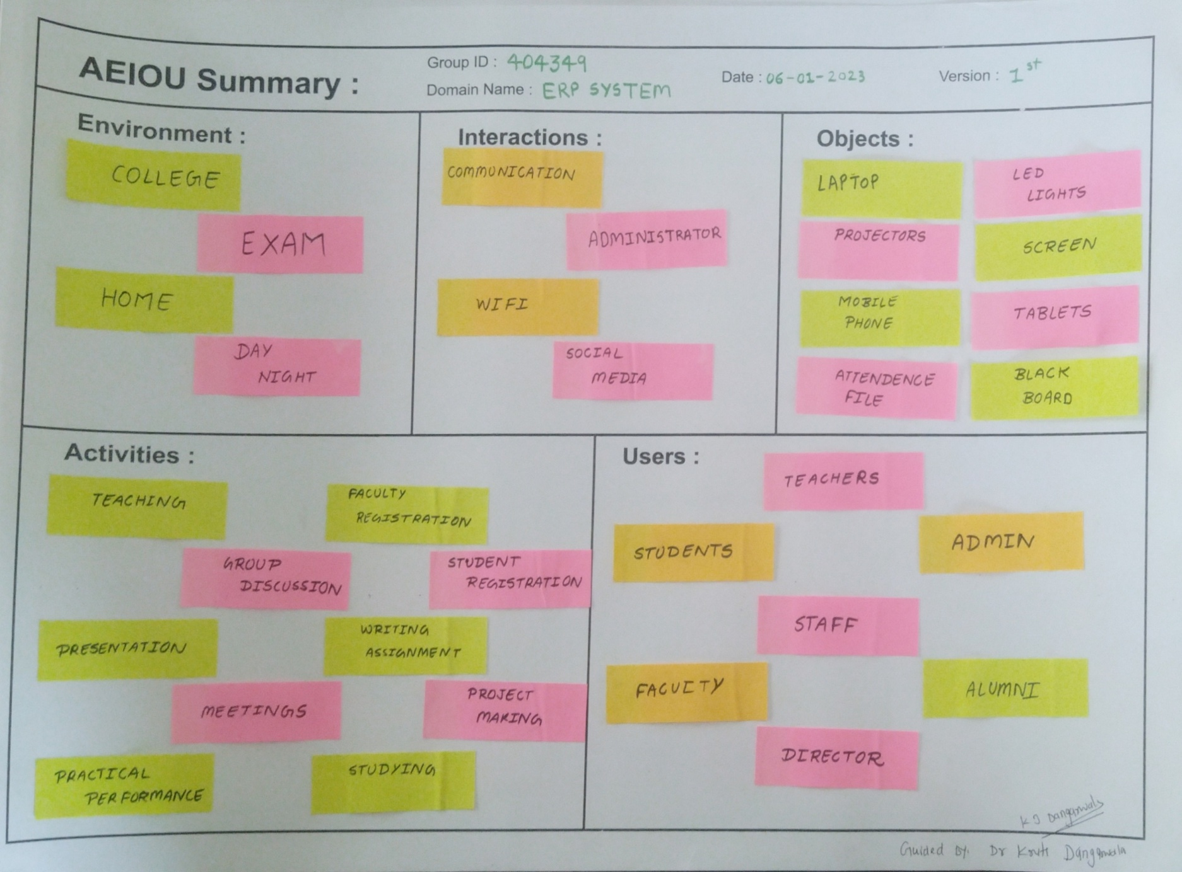

Slide 6
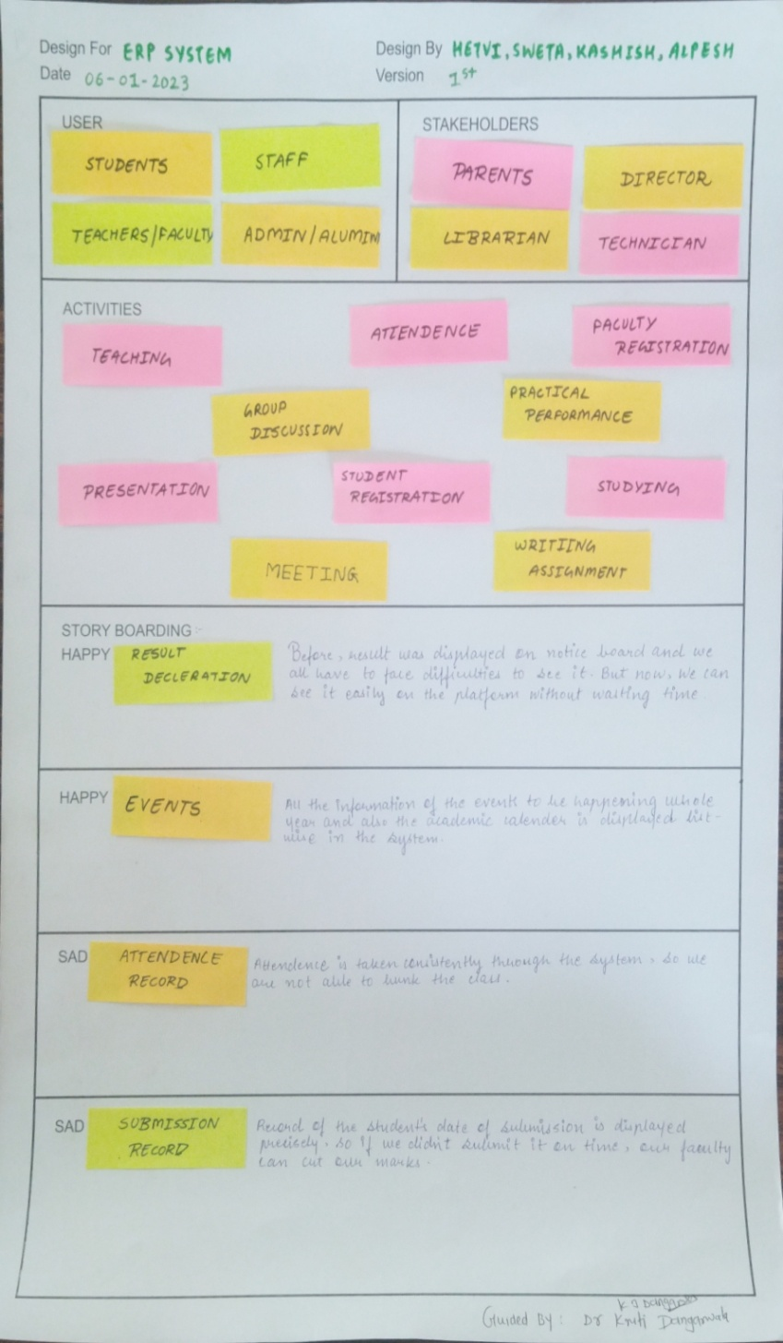
Empathy Mapping / Framework:-
➢ User
➢ Stakeholders
➢ Activities
➢ Story boarding
User :-
Admin
Staff
Students
Stakeholders :-
Parents
Director
Librarian
Technician
Activities :-
Teaching
Presentation
Student Registration
Practical Performance
Writing Assignment
Meeting

Slide 7
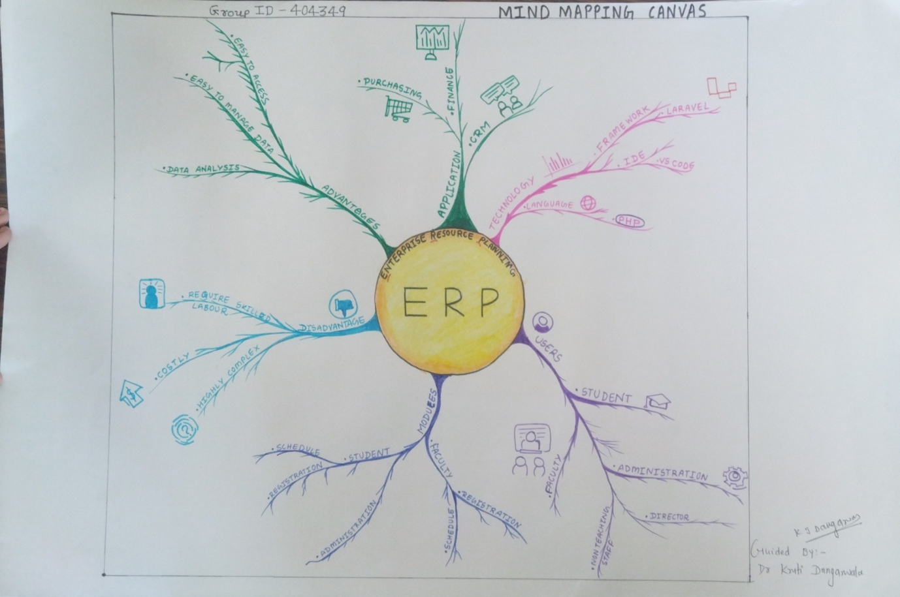
Mind Mapping/Framework:
A Mind Map is an easy way to brainstorm thoughts organically without worrying about order and structure. It allows you to visually structure your ideas to help with analysis and recall.
A Mind Map is a diagram for representing tasks, words, concepts, or items linked to and arranged around a central concept or subject using a non-linear graphical layout that allows the user to build an intuitive framework around a central concept.

Slide 8
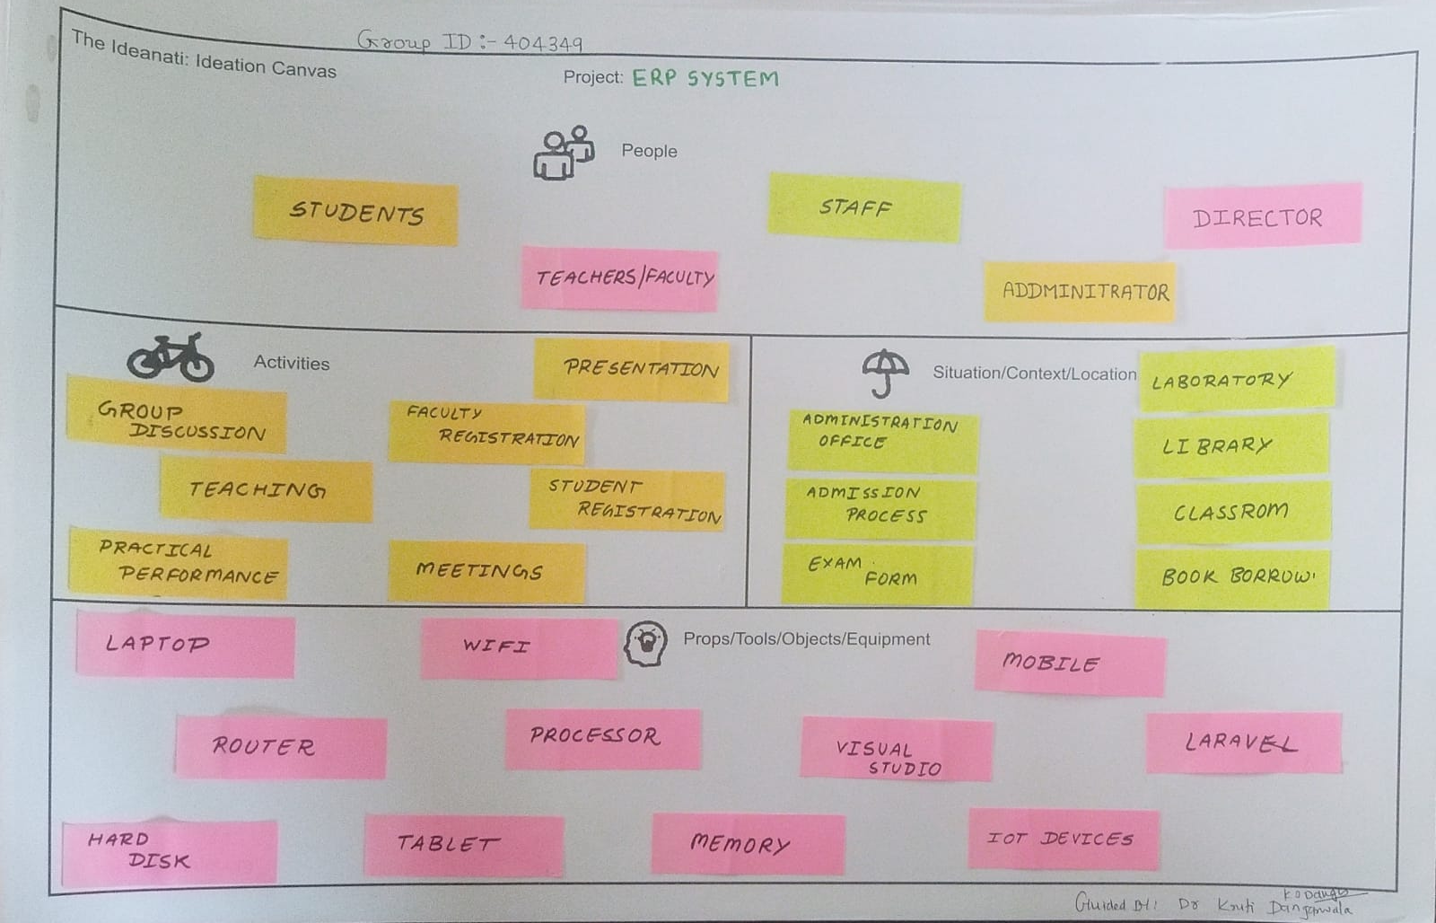
Ideation Canvas / Framework
People
Activities
Situations/context/location
Props/tools/objects/equipment
People:-
Student
Teachers
Staff
Administrator
Activities :-
Group Discussion
Teaching
Student Registration
Faculties Registration
Presentation
Situation/context/location :-
Administration Office
Administration Process
Exam Form
Book Borrow
Props/tools/objects/equipment:-
Computer
Laptop
Mobile
Wi-Fi
Router
Processor
Laravel
Tablet
Memory
Hard Disc

Slide 9
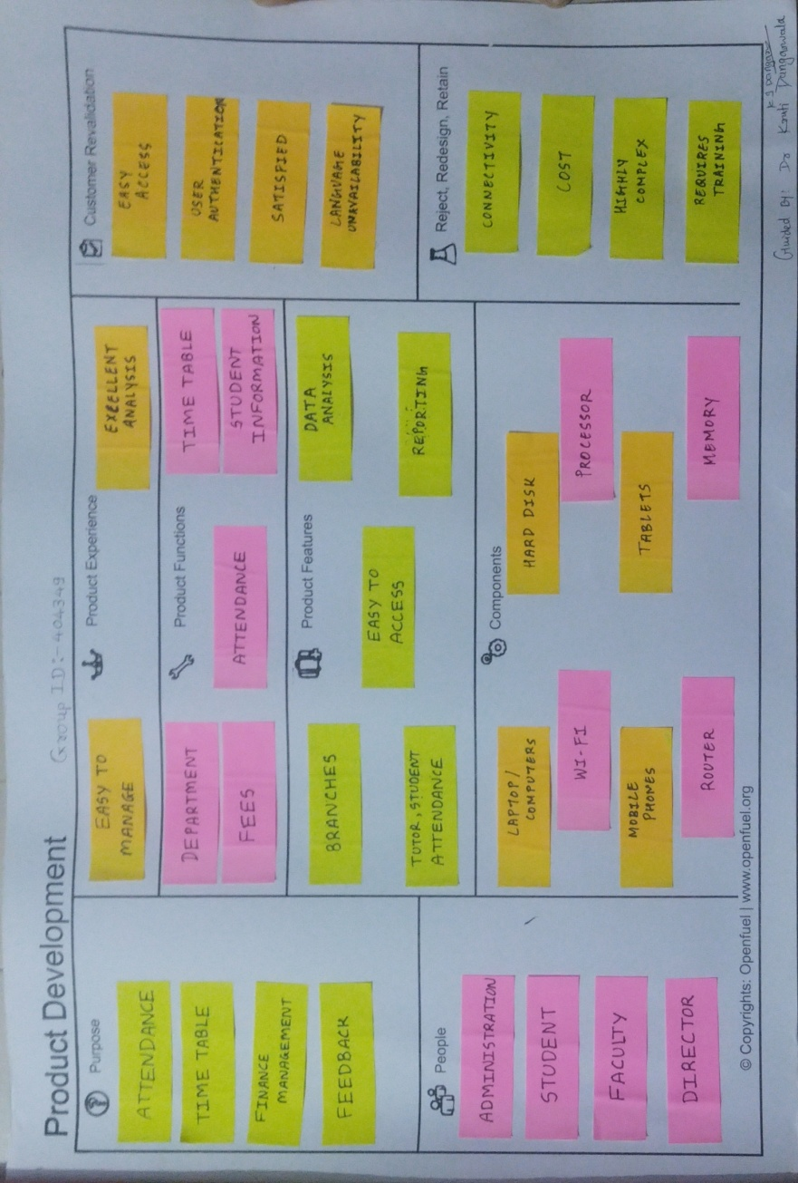
Product Development Canvas / Framework :-
➢ Purpose
➢ People
➢ Product Experience
➢ Product function
➢ Product features
➢ Components
➢ Customer revalidation
➢ Reject/Redesign/Retain
Components :-
Computer
Wi-Fi
Memory
Mobile
Laptop
Purpose :-
Attendance
Time Table
Finance Management
Feedback
People :-
Student
Faculty
Administration
Director
Product Experience:-
Easy To Manage
Excellent Analysis
Product Functions :-
Department
Fees
Attendance
Time Table
Student Information
Product Features :-
Branches
Easy to Access
Tutor , Computer
Data Analysis
Reporting

Slide 10
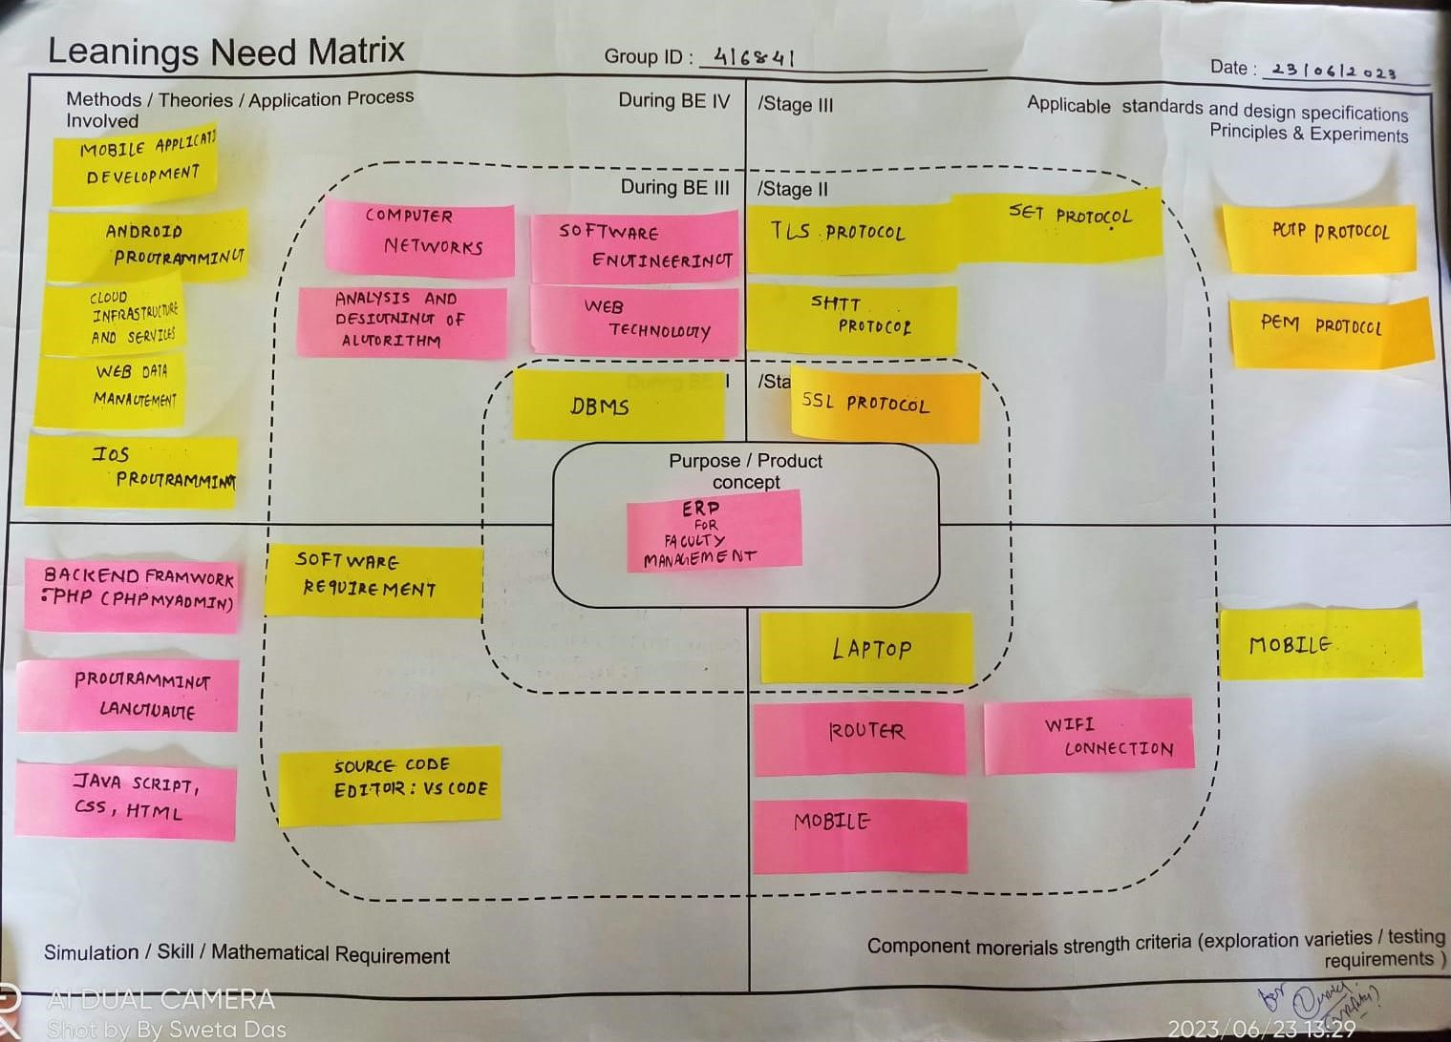
Learnings Need Matrix Canvas:
➢Methods:
• Probability & Statical data
• Learning PHP 7.8
• Web data Programming
• Android Programming
➢Simulation/Skill:
• Java script
• PHP
• Graphical User Interface
➢Components Morerials Strenght Criteria:
• Laptop
• Mobile
• User Interface
➢Applicable Standaeds and Design Specification Principles and Experiments :
• Institution Head Permission
• Faculty Permission

Slide 11
Research on various ERP system
Edusys: The EduSys College software’s responsive & smooth screen layouts help to serve great user experience (UX) to any internet-accessible devices such as smartphones, iPhones, iPad, tablets, phablets, laptops, desktop, AI-embedded-devices and more
Mastersoft: MasterSoft College Management System is an end-to-end solution for colleges to improve operational efficiency & institutional outcomes by automating the Student-Faculty lifecycle & campus administration. This college ERP software is designed keeping in mind the different operations of a college.
Skolaro: Skolaro is a cloud-based ERP system designed specifically for K-12 schools. It provides a suite of modules that help schools manage their academic and administrative operations efficiently.
Deskera’s Faculty Management software: Deskera is an all-in-one cloud-based accounting software that helps small business run their business efficiently anytime, anywhere, on any device.

Slide 12
References
Edusys
https://www.edusys.co/en-in/college-management-software.html
MasterSoft
https://www.iitms.co.in/blog/faculty-management-system-software-becoming-a-necessity.html
Skolaro
https://www.skolaro.com/college-erp
Deskera’s Faculty Management software
https://www.deskera.com/lms/faculty-management

Slide 13
Thank You

